Slide 1
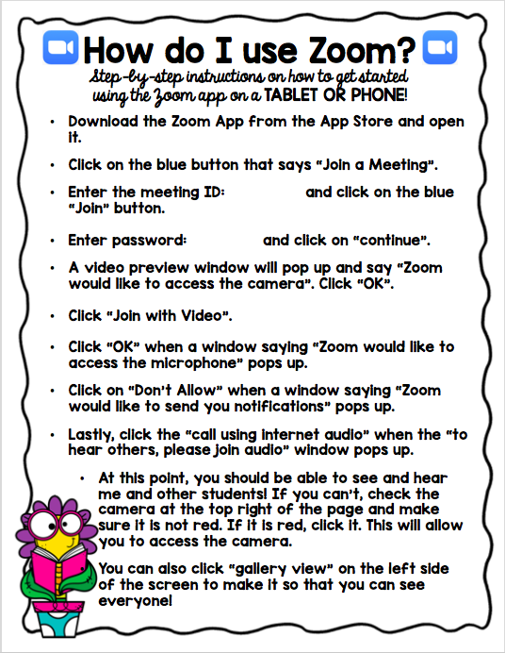
_________
_________

Slide 2
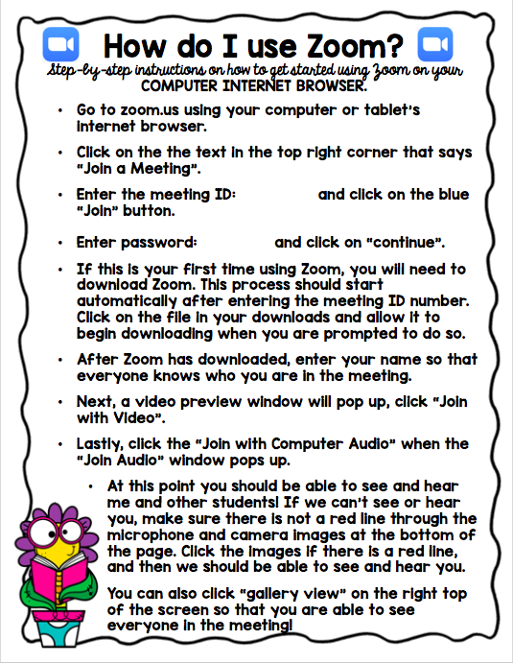
__________
_________

Slide 3


How do I use Zoom?
Step-by-step instructions on how to get started
using the Zoom app on a TABLET OR PHONE!
Download the Zoom App from the App Store and open it.
Click on the blue button that says “Join a Meeting”.
Enter the meeting ID: and click on the blue “Join” button.
Enter password: and click on “continue”.
A video preview window will pop up and say “Zoom would like to access the camera”. Click “OK”.
Click “Join with Video”.
Click “OK” when a window saying “Zoom would like to access the microphone” pops up.
Click on “Don’t Allow” when a window saying “Zoom would like to send you notifications” pops up.
Lastly, click the “call using internet audio” when the “to hear others, please join audio” window pops up.
At this point, you should be able to see and hear me and other students! If you can’t, check the camera at the top right of the page and make sure it is not red. If it is red, click it. This will allow you to access the camera.
You can also click “gallery view” on the left side of the screen to make it so that you can see everyone!

Slide 4
How do I use Zoom?
Step-by-step instructions on how to get started using Zoom on your COMPUTER INTERNET BROWSER.
Go to zoom.us using your computer or tablet’s internet browser.
Click on the the text in the top right corner that says “Join a Meeting”.
Enter the meeting ID: and click on the blue “Join” button.
Enter password: and click on “continue”.
If this is your first time using Zoom, you will need to download Zoom. This process should start automatically after entering the meeting ID number. Click on the file in your downloads and allow it to begin downloading when you are prompted to do so.
After Zoom has downloaded, enter your name so that everyone knows who you are in the meeting.
Next, a video preview window will pop up, click “Join with Video”.
Lastly, click the “Join with Computer Audio” when the “Join Audio” window pops up.
At this point you should be able to see and hear me and other students! If we can’t see or hear you, make sure there is not a red line through the microphone and camera images at the bottom of the page. Click the images if there is a red line, and then we should be able to see and hear you.
You can also click “gallery view” on the right top of the screen so that you are able to see everyone in the meeting!

Slide 5


Thank You!

